Slide 1
Automatic Calculation of Translator
Productivity Improvement
when Using Machine Translation
Andrzej Zydroń CTO XTM Intl
ASLING TC38 London 2016

Slide 2
Language is difficult
Language appears to be easy:
But we forget that it took years of daily practice to master
Typically 7 years (2,555 days) full time!

Slide 3
The nature of human language
Human language is learned symbolic communication system is that it is infinitely flexible
Meanings can be changed and new symbols created
It is messy, often irregular and based more often than not on acquired conventions
Language is used a social tool for differentiation and group consensus

Slide 4
The nature of human language
Often ambiguous and reliant on prior knowledge
They ate their pizza with anchovies

Slide 5
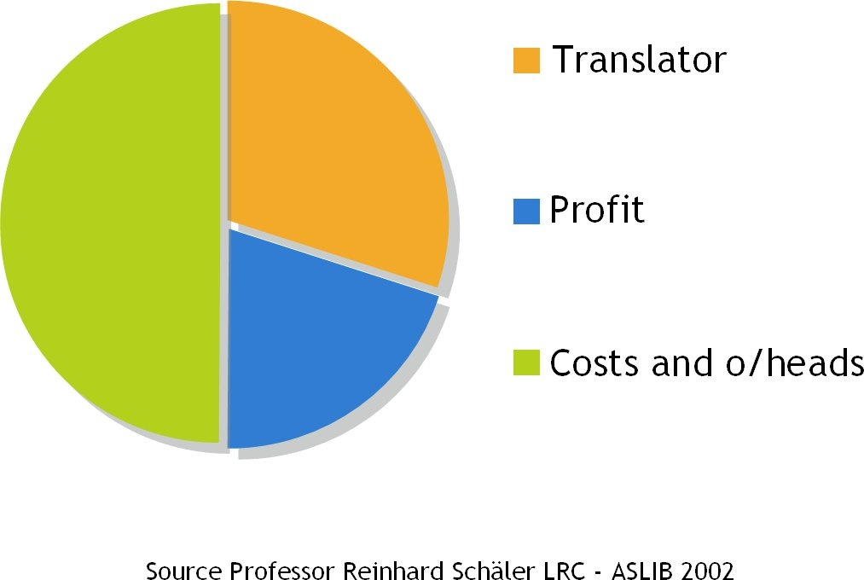
Perspective

Slide 6
Morphology
Languages can vary considerably in terms of morphology and grammar
Gender, Case, Agreement etc.
Languages with primitive morphology:
English, Mandarin, French
Languages with very rich morphology
Russian, Finnish, Turkish
Second law of thermodynamics applies:
You cannot create something from nothing
Notes:
XTM reduces the cost and throughput times of projects by allowing translation teams to collaborate effectively.

Slide 7
MT Development
Rule based 1950+
Statistical Word Based 2000
Statistical Phrase Based 2008
Statistical Hybrid Word/Phrase + Grammar 2012
Statistical Deep Learning: 2015
Neural Network
Powerful Language Models
Dictionary, disambiguation (BabelNet)
Notes:
XTM reduces the cost and throughput times of projects by allowing translation teams to collaborate effectively.

Slide 8
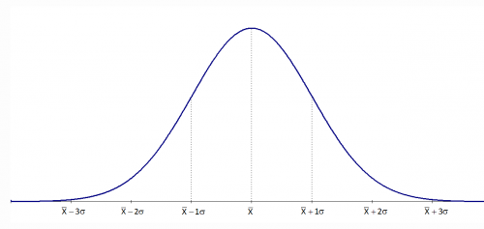
SMT
Limitations:
More data != better performance
Diminishing returns

Slide 9
Limits of SMT technology
The limitations of computational linguistics:
Syntax
Morphology
Grammar
Language model size
Training set quality and size: data dilution
Domain similarity
Homographs, Polysemy
OOV: Out of Vocabulary words
Word and phrase alignment
Notes:
XTM reduces the cost and throughput times of projects by allowing translation teams to collaborate effectively.

Slide 10
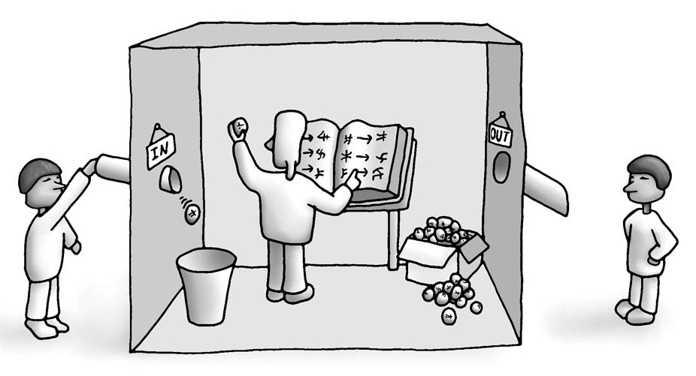
John Searle’s Chinese Room

Slide 11
In Order to Translate you need to UNDERSTAND
The Ultimate MT Limitation

Slide 12
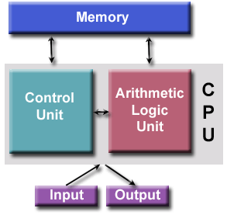
Turing/von Neumann architecture
70 years and no change

Slide 13
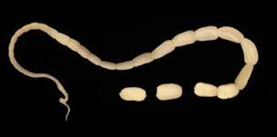
Turing/von Neumann architecture
limitations
=

Slide 14
The right tool for the job

Slide 15
Need better performance:

Slide 16
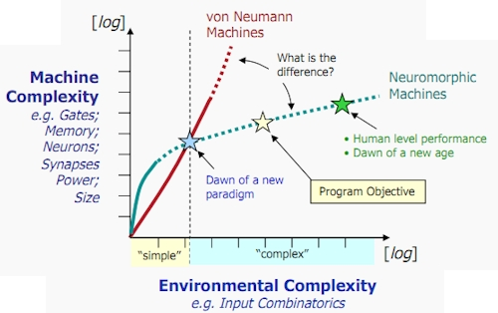
Von Neuman chips do not scale with data
DARPA Cat brain project

Slide 17
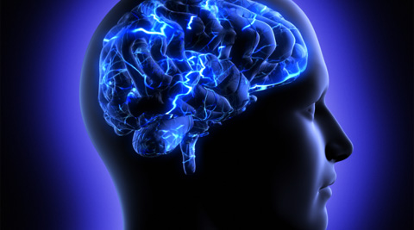
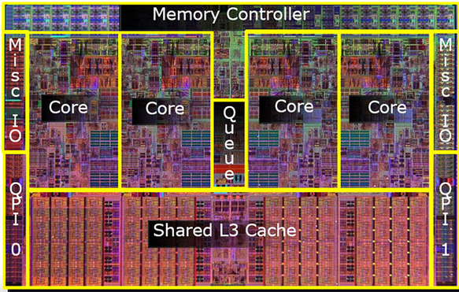
Defining Intelligence
Human vs Computer
Human 200 OPS
Computer 82,300,000,000 OPS
vs
Notes:
XTM reduces the cost and throughput times of projects by allowing translation teams to collaborate effectively.

Slide 18
How the brain works
30 billion cells, 100 trillion synapses
Notes:
XTM reduces the cost and throughput times of projects by allowing translation teams to collaborate effectively.

Slide 19
Turing/von Neumann architecture
limitations
Very Good
Very Poor

Slide 20
How can we assess the potential productivity savings by using MT?
Current MT providers answer:
Well it depends…

Slide 21
Theoretical limits of MT
1
HT
en-US > en-GB
100%
en-US > fr-FR
75%
Morphology Delta =
Language Closeness
SMT
% productivity
improvement
en-US > de-DE
45%
en-US > ru-RU
25%
0
Quality
1

Slide 22
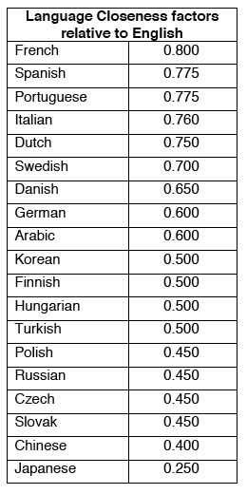
Language Similarity

Slide 23
Training Set Size Factor
Where Size is the actual training data size and Size' is an empirical value which makes TSSF equal 0.5.

Slide 24
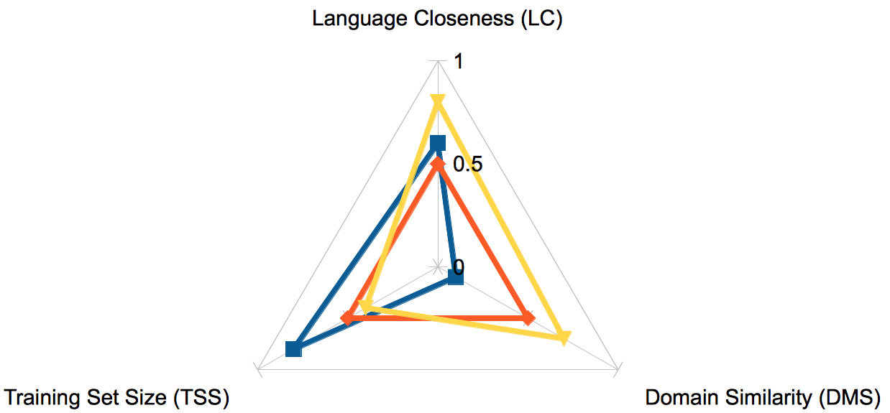
Estimating Percentage Reduction in Translator Effort (PRTE)
PRTE = (LC x TSSF x DMS) x 100%

Slide 25
PRTE Calculation Examples
Translating from en-US to en-GB we can assume a LC value of 1. If we have an ideal reference TSSF of 1 and an ideal DMS of 1, we arrive at a PRTE of:
1x1x1x100 = 100%
Translating from en-US to fr-FR we can assume a LC value of 0.8. If we have a slightly less that ideal TSSF of 0.75 but with an ideal DMS of 1, we arrive at a PRTE of:
0.8x0.75x1x100 = 60%
Translating from en-US to ja-JP we can assume a LC value of 0.2. If we have an ideal TSSF value of 1 and an ideal DMS of 1, we arrive at a PRTE value of:
.2x1x1x100 = 20%

Slide 26
Question and Answer session
Better Translation Technology

Slide 27
Contact Details
XTM International
www.xtm-intl.com
Register for future Webinar sessions
www.xtm-intl.com/demos
Contact
azydron@xtm-intl.com
+44 (0) 1753 480 479

