Slide 1
The art of subtitling within the European institutions
A quality-focused approach
Luxembourg, 17/11/2016
Ayten Dersan Business Development
Translation Support Department

Slide 2
The Translation Centre’s mission
To meet the growing translation needs of a large number of European agencies, offices and bodies
To absorb any surplus work of the Institutions which have their own translation services
To meet the translation needs of other institutions within complex projects
to actively participate in inter-institutional cooperation with a view to rationalising working methods and achieving global economies of scale, e.g. IATE project

Slide 3
The Translation Centre’s Clients
At present,
the Translation Centre has cooperation agreements
with 63 EU bodies and Institutions

Slide 4
The Centre’s services
Translation
Modification
Editing
Revision
Linguistic consulting
Terminology
Term lists
Revision of term lists
Subtitling since January 2015

Slide 5
Definitions
Subtitling is the technique of translating a film or a television dialogue or speech –audiovisual translation- into text that is usually displayed at the bottom of the screen.
Closed captioning is text on screen representing speech and sound effects that may not be audible to people with hearing impairments, synchronised as closely as possible to the sound.
+Re-speaking

Slide 6
3 questions
1. What if we receive not one but many audios/videos to transcribe and subtitle?
2. How to harmonise and optimise the approach when creating a new subtitling job?
3. How to generate multilingual subtitles and keep high quality standards?

Slide 7
1. What if we receive not one but many audios/videos to transcribe and subtitle?
Linguistic and technical analysis
Conversions and pre-editing through ASR
Spotting of the video through subtitling editor
Example

Slide 8
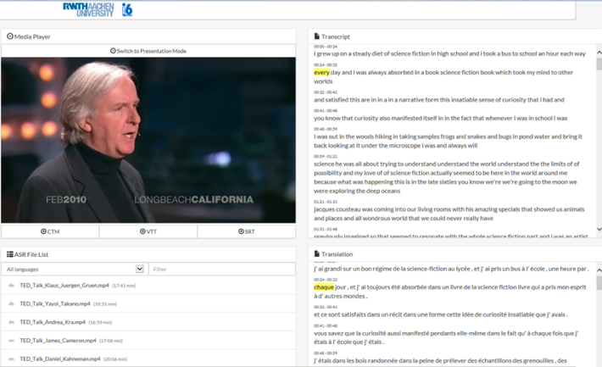
Speech Recognition engines tested
Dragon naturally speaking
RWTH tool https://www-i6.informatik.rwth-aachen.de/web/Webdemo/CDT
MLLP UPV toolkit http://ttp.mllp.upv.es/
EML tool
SAVAS - Synthema
Youtube
Google

Slide 9
2. How to harmonise and optimise the approach when creating a new subtitling job?
Subtitling is an adaptation under constraints:
Related to the subtitling technique
Space constraints
Time constraints
Synchronisation
Mixture of text & speech
Background music
Related to the functioning of EU institutions
In-house vs outsourcing
Organise training for in-house subtitlers-to-be
Logistics requirements (subtitling lab, PCs, headphones, keyboards)
Financial commitments (subtitling editors)
Workflow definition with all stakeholders (stages, staff involved, time frames, deadlines)

Slide 10
Technical rules (1/4)
Intelligibility constraints
Concise, uncomplicated, no unusual words, no wordy structures
One idea = one subtitle
Space constraints
Clear, concise message
Maximum 2 lines (3 lines is not allowed)
Line length: 37-40 characters (incl. punctuation + spaces)

Slide 11
Technical rules (2/4)
Time constraints
Spotting: segmentation into 1- or 2-line blocks.
Syntactically and semantically self-contained
The line breaks and the subtitle breaks to be done
at grammatical and logical points.

Slide 12
Technical rules (3/4)
The subtitling editor:
Specifies where each subtitle starts & ends
Specifies what goes on 1st line, or on 2nd line (language-specific logical and grammatical splitting of text)
Specifies how long subtitle is displayed (1-6 seconds)
Must appear when oral discourse starts or is heard & stay on screen until end of speech segment (even a little longer)
Must ensure no random gaps are left between consecutive subtitles
Usually 15 characters per second of second of subtitle duration
Translation should be shorter than original source text

Slide 13
Technical rules (4/4)
Subtitles must be synchronised with
the dialogue, respecting the minimum reading speed, and the general reading rhythm of the film.
the shot changes (change within the same scene, or change from one general view to another general view).
the sound (and names, titles, dates and other elements that can be recognised from one language to the other should be kept )
the image

Slide 14
3. How to generate multilingual subtitles & keep high quality standards?
The main linguistic requirements of subtitling is reduction
(about 25-50%):
Deletion (or omission of empty words);
Merging questions or replies;
Décimation;
Expansion or explicitation;
Résignation;
Use of shorter synonyms;
Try to respect accents, dialects, regionalisms and register if the dialogue imposes it;
"Early starts", repetitions, pending sentences, sentences with an ellipsis

Slide 15
Lingustic rules (2/3)
Ellipsis dots or continuation dots can be used to mark a break or a hesitation or an interruption
Quotation marks are used for titles, proper names, nicknames, slang, irony or contempt, for example
Upper case is used for instance when a crowd is yelling
Exclamation marks show emphasis (to be used with moderation)
Currencies are written in letters, as much as possible.
For example: It costs 9 dollars.

Slide 16
Linguistic rules (3/3)
The only abbreviations accepted are units of measurement.
Numbers 1 to 12 and round numbers and fractions can be written in letters.
A number followed by an abbreviated unit of measurement is written in numbers (e.g. 9 km)
Numbers containing more than 5 digits are grouped 3 by 3
Italics are used for Off scene voice and songs

Slide 17
Subtitling workflow

Slide 18
Towards more real-time & machine-based processing…
Analyse requirements of possible closed-captioning and live subtitling needs of institutional clients
Enhance automations and integration of workflow
Generate, enrich and increase performance of EU ASR engines and EU-restricted content
Define and develop common use of data and resources

Slide 19
Any questions?
Speech
Text
Speech

Slide 20
Thank you!
Ayten Dersan Business development
Translation Support Department
Mobile: +352 621 16 22 96
Tel: +352 42 17 11 505
ayten.dersan@cdt.europa.eu
Business.development@cdt.europa.eu

