Slide 1
Can you trust a TM? Results of an experiment conducted in November 2015 and August 2016 with students and professional translators. Daniela Ford Centre for Translation Studies (CenTraS) University College London daniela.ford@ucl.ac.uk

Slide 2
Agenda
Motivation for the experiment
Setup of the experiment
Evaluation of the results
Summary and Conclusions

Slide 3
Motivation for the experiment
Lynne Bowker: Productivity vs Quality? A pilot study on the impact of translation memory systems (published in Localisation Focus in March 2005)
3 student groups (EN <-> FR):
Translate without a TM tool
Translate with a TM tool and a TM of good quality
Translate with a TM tool and a TM containing mistakes
Results: 1st group translated relatively well but 2nd & 3rd groups were faster, however, 3rd group did not pick up on all mistakes -> students may not be critical enough when using a TM tool

Slide 4
Sample groups for this experiment
November 2015, CenTraS @ UCL:
69 MSc Trans students (~20-40 years); EN > 14 languages
IT, CH-ZH, CH-TW, RU, SV, JA, PT, EL, DE, FR, ES, NO, PL, KO
After 12 contact hours in class, most new to TM tools
August 2016, a company in Saudi Arabia:
30 professional translators (~22-50 years); EN > AR
After 1 day face-to-face training, all new to TM tools

Slide 5
Sample text and TM
14 sentences (subject: IT) plus modified TM
New sentences
Correct & incorrect 100% matches
Fuzzy matches
CenTraS students used WFA (Wordfast Anywhere)
Professional translators used SDL Trados Studio

Slide 6
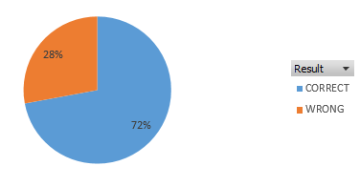
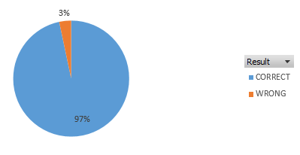
Evaluation of the results: Correct 100% matches
4 sentences (100% matches from TM, should not have been changed)
72% of the student translators left the 4 sentences unchanged.
97% of the professional translators left the 4 sentences unchanged.
Notes:
There are a number of possible interpretations for this result: The student translators may have been more thorough or more inexperienced and therefore changed a perfectly good translation. The professional translators were from Saudi Arabia and the Arabic provided to them was in a different Arabic dialect, or the professional translators simply did not consider it important to really look at the translation critically. A comment which the author kept hearing from the professionals was: “We are only in training and you will delete the files anyway so it doesn’t matter whether we do a good job or not – this training is only about the process of learning how to work with the tool, not about producing a nice translation”.

Slide 7
Evaluation of the results: New sentences
2 sentences which had to be translated from scratch
Some professional translators left these empty; the students translated all the sentences.

Slide 8
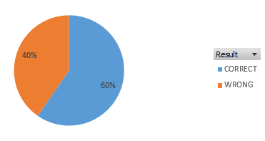
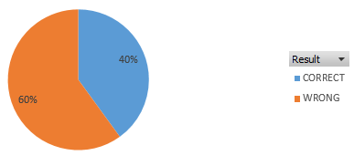
Evaluation of the results: Incorrect 100% matches
5 sentences given as 100% matches but containing mistakes (e.g. not automatically -> automatically; formatting differences…)
60% of the student translators spotted the mistakes in the incorrect 100% matches and corrected them.
Only 40% of the professional translators spotted the mistakes in the incorrect 100% matches and corrected them.
Notes:
This is quite a surprising result, and again, several interpretations are possible. Upon querying this with some of the professional translators, the author was told that “we spotted the difference but didn’t change it”. Whether this is true or simply a way of saving face and not admitting that this was missed is not clear.

Slide 9
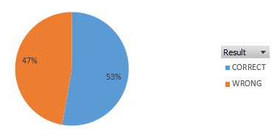
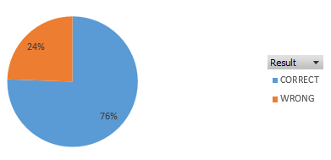
Evaluation of the results: Fuzzy matches
3 fuzzy matches from the TM which should have been edited (e.g. PCs, Macs and Android tablets -> PCs and Android tablets)
Only 53% of the student translators corrected the fuzzy matches.
76% of the professional translators corrected the fuzzy matches.

Slide 10
Evaluation of the results: Other aspects
Underline goes over the space & too many spaces & (professional translators)

Slide 11
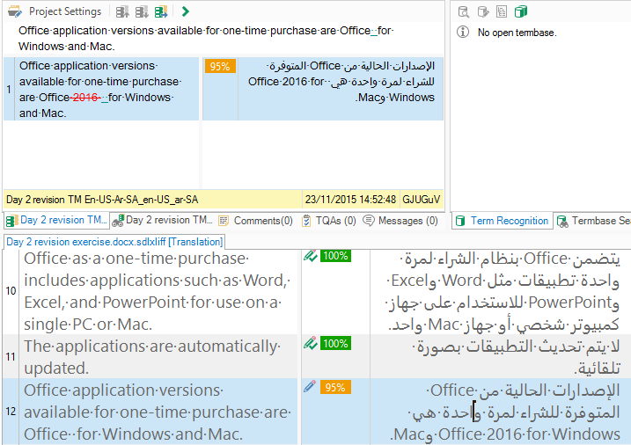
Evaluation of the results: Other aspects
Unconfirmed segment (professional translators)

Slide 12
Evaluation of the results: Other aspects
Formatting errors (professional translators)

Slide 13
Summary and Conclusions
Professional translators fared better at editing fuzzy matches than the students; paid more attention to detail on word level
Student translators fared better at correcting incorrect 100% matches
Professional translators lacked more attention to detail on layout level (double spaces, formatting problems…)
Some professional translators did not translate all new sentences
November 2016: Experiment repeated with 61 students and 2 new languages (Romanian, Hungarian)
Is it blind trust in a TM OR “not my responsibility”?

Slide 14
Thank you! Can you trust a TM? Results of an experiment conducted in November 2015 and August 2016 with students and professional translators. Daniela Ford Centre for Translation Studies (CenTraS) University College London daniela.ford@ucl.ac.uk

