Slide 1
Workshop:
(How) can interpreting fees be cost-effective
for all parties involved?
Anja Rütten
Translating and the Computer 38
November 16 and 17, 2016
London

Slide 2
Background
Basically, what a client buys from an interpreter is a certain amount of his or her lifetime. The time dedicated to an interpreting assignment involves both the primary task of interpreting and the secondary task of accompanying knowledge work (preparation, ad hoc research, follow-up). The duration of interpreting services as well as the secondary knowledge work may vary from several minutes to several days or even weeks. The percentage of primary and secondary work involved in one assignment may vary greatly. The working time provided by the interpreter may be paid in different units like minutes, hours or days.

Slide 3
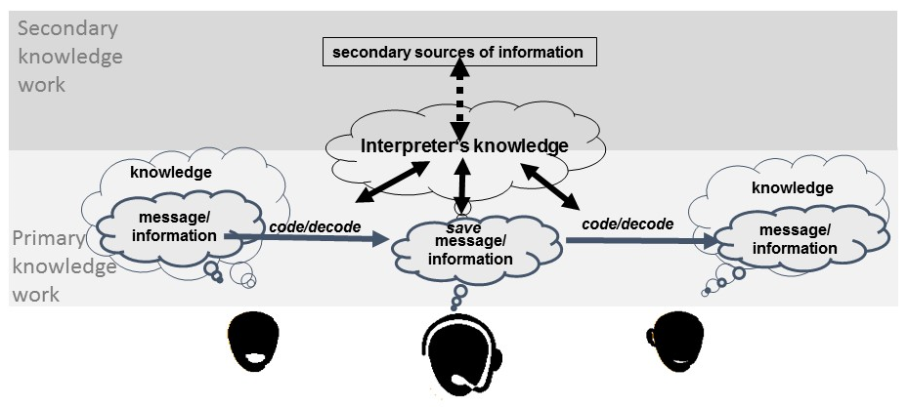
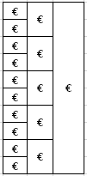
Background

Slide 4
Perspectives
Ideally, the workshop participants should be the parties to the supply chain:
- language service providers,
- clients and
- intermediaries
As well as more “neutral” parties like
software experts to provide inspiration as to the technical possibilities and
academics to shed some scientific light on a very practical subject.

Slide 5
1st point for discussion – current situation
Briefly present yourself and your role in the interpreting market
Describe the payment practice in your market/country
Describe the level of secondary knowledge work interpreting assignments typically involve
Do you feel one matches the other?

Slide 6
2nd point for discussion – past, present and future
Has digitalisation changed workflows and payment practice?
In which way?
How can digitalisation can bring changes for the better to the different parties of the supply chain?

Slide 7
Follow-up
Results of this workshop could be shared
with different professional/industry organisations
if the workshop participants wish so.

