Slide 1
The Future of translation Technology
Massimo Ghislandi
EVP Translation Productivity

Slide 2
5 Thoughts
Quality
Productivity
New ways
of working
System and
workflow
integration
User
experience

Slide 3
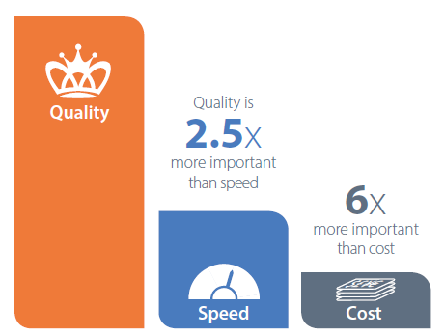
believe they would lose competitive advantage without translation productivity tools
72%

Slide 4
A Cloudy Future
Machine Translation: is no longer a dirty word
35% Only a third think cloud-based tools are as productive as desktop-based tools
SIMPLICITY
FUNCTIONALITY
16% of respondents believe that TP software innovation has peaked
Open Platforms

Slide 5
Key Technology Trends
CLOUD COMPUTING
MACHINE LEARNING
BIG DATA
CHANGING WORKPLACE
USER EXPERIENCE

Slide 6
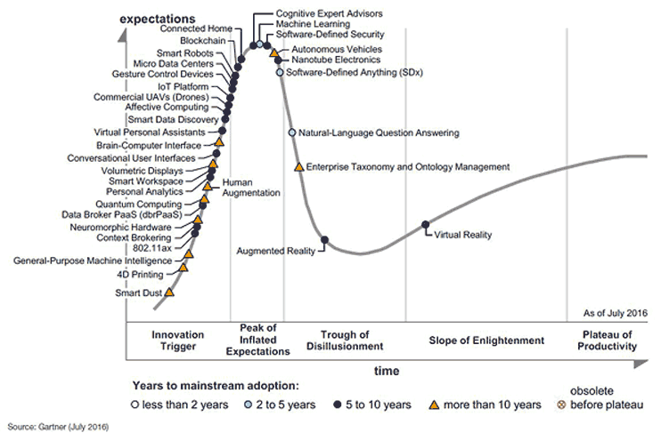

Slide 7
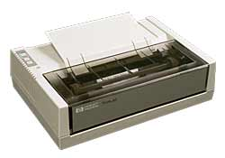
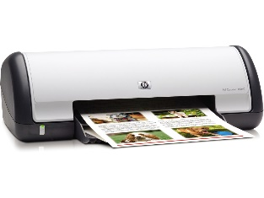
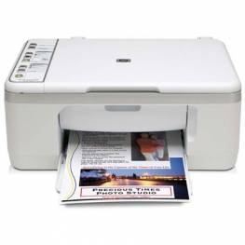
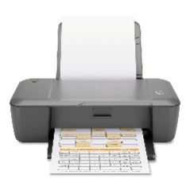
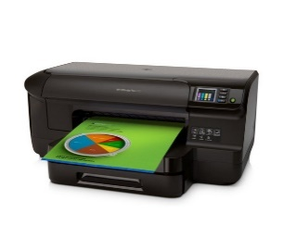
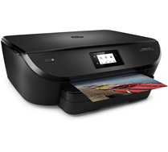
Modern Content
Digital content explosion
300X more data in 2020 compared to 2005
The rise of XML:
XML “is now part of the fabric of business. It is the default mechanism for representing data in a host of areas across the IT landscape and, if there is any requirement for interoperability between systems then XML is likely to be the data interchange medium.”
First HP Inkjet Printer in 1984
+ demand for immediacy = shorter turnaround times
Now multiple models updated regularly

Slide 8
Modern Workplace
Technology is now enabling virtual teams to work together much better
Global mobile Workforce 1.32 billion in 2014 *
Expected to grow to 1.75 billion by 2020
In the last 10 years we have moved from a physical space organised for collaboration built through furniture to a digital space for collaboration that we organise through networks
Technology at work evolves as the culture changes and vice versa, when culture changes technology is used when it is meaningful & relevant to do so

Slide 9
1/3 of customers don’t use any quantitative metrics to assess quality
How do you measure quality?
Quality
How do you measure quality?
While 7% turn a blind-eye to quality – and make no attempt to measure quality.
Half use both qualitative AND quantitative feedback when measuring translation quality.
Quality is IMPORTANT – as 93% do some form of assessing quality.
BUT ONLY 1 in 20 (5%) use standardized, quantitative metrics when measuring translation quality.
Innovators
Early Adopters
Early Majority
Late Majority
Laggards
“The Chasm”
Technology Adoption Cycle
Base: 2784

Slide 10
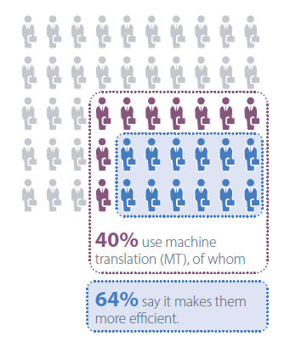
Current MT usage
While a quarter still believe that MT is a threat, closer to half believe that it’s driving the future of translation productivity
Of those who use it, almost three-quarters are more likely to recommend it than not; and corporates are the most enthusiastic segment
40% of the respondents are using MT, and they are seeing significant value. And this is before new advances in machine learning have been widely applied to this field.
Source :SDL Industry Technology Research March 2016

Slide 11
Cost savings through MT
Does MT make you more efficient?
How much time / cost do you save?
The majority can expect a time saving of 20-30%
1 of 3 can expect a time saving of 40% or more.
Corp
Freelance
LSP

Slide 12
How do you best compete? Investment in TP tools is seen as the #1 way for doing more with less.
Invest in translation productivity tools
Review and Improve processes
Productivity
39%
There is a preference for improving technology & processes (67%) over adding more costs.
Increase Headcount
28%
Outsource to external agencies
18%
14%
2.5x
3.5x
1.5x
Base: 2784

Slide 13
Adopt better way to assess quality
Increase in Machine Translation usage
Increase use in collaboration tools
Better integrations and increased process automation
Easier to use tools which retain sophistication

