Slide 1
Automated detection and correction of errors in real-time Speech To Text
Andrew Lambourne – Leeds Beckett University
Lindsay Bywood – University of Westminster

Slide 2
Overview
SLT applications in media industry
SLT-assisted workflows
Specific use-case for research
Sample data analysis
Proposed experiments
Target tools and capability

Slide 3
SLT applications in the media industry (current and future)
Localisation
- content producers want to sell into as many markets as possible
- hence content is localised by inter-lingual subtitling or dubbing
Access subtitles
- deaf, deafened and hard-of-hearing people have a right to access media
- intra-lingual subtitles convey the content of the audio track
Audio description
- blind and partially sighted people have a right to access media
- audio description conveys a summary of the visual content

Slide 4
SLT tools used in media applications
Transcription
- speaker-independent subtitle transcription of offline media dialogue
- speaker-dependent subtitling (“re-speaking”) during live broadcasts
Translation
- conversion from “timed template” into multiple target languages
- some real-time translation of live broadcasts via human intermediary
Speech synthesis, cartoon faces, sign language
- audio description content produced by synthetic speech
- cartoon facial movements, sign-language avatars

Slide 5
Workflow challenges when using SLT
Productivity is key
- automated translation / transcription does not produce perfect results
- challenges: vocabulary, range of styles, breadth of domains, languages
- freelance workforce is used to minimize localisation / accessibility costs
- time is normally of the essence
Tipping points
- a) when fixing up an imperfect first pass is quicker than from scratch
- b) when timeframe is constrained (but quality is compromised)
- c) when the task is otherwise impossible (160wpm transcript)

Slide 6
The costs of errors in automation tools
Impacts on productivity
- designing a fast and efficient UI for textual error correction is difficult
- reading text, finding errors, correcting can be slower than from-scratch
- seeing errors in a live transcript can disrupt concentration on dictation
- people tend to resist using “not very good” technology for professional tasks
Business costs
- access subtitle quality is normally governed by regulator
- errors in (e.g.) DVD language translations can be very costly
- squeezed margins do not cover costs of re-doing faulty work

Slide 7
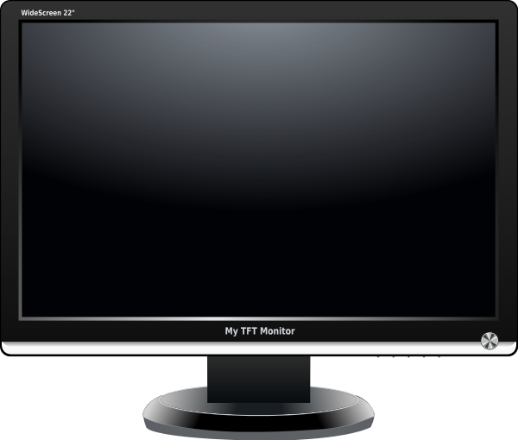
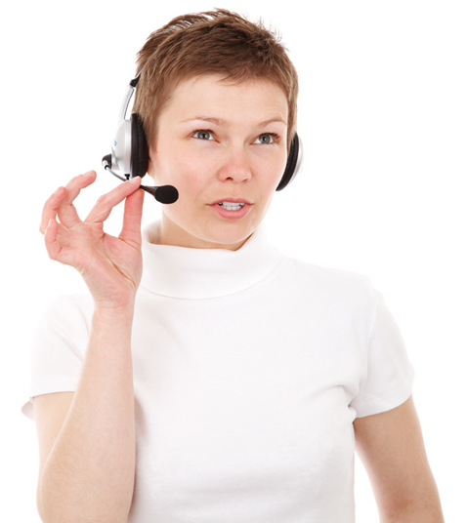
How best to improve accuracy?
Specific use-case
- real-time live subtitle “re-speaking”
- trained native speaker using trained speaker-dependent system
- vocabulary pre-researched and loaded into voice model
- speech macros for command/control and disambiguation
Live subtitle text

Slide 8
Proposed research approach
Be realistic
- we do not have the skills or resources to create new tools from scratch
- existing manufacturers do not see sufficient opportunity in media space
- hence we are adopting a “post-processing” approach
- also aim to be generic rather than using a specific SDK
Top-level methodology
- review output from commercial live subtitle producer
- identify and seek to categorise errors in live transcripts
- assess opportunity for automated detection and correction

Slide 9
Initial analysis of sample data
Sample set
- “as transmitted” subtitle text for 23 re-spoken live TV broadcasts in English
- genres: various chat shows, soccer commentary, topical discussion
- programmes varied from 30 min to 2 hours duration
- mostly around 4,000-5,000 words, sports commentary was 18,000 words
Informed by knowledge of the production process
- listen to the TV broadcast sound at up to say 200wpm
- simultaneously re-speak as precisely as possible
- include punctuation, colour commands, some contraction
- pre-defined “voice macros” if needed for names/disambiguation

Slide 10
Initial classification of error types
Single-word phonetic blurring
Single-word homophone
Missing single word
Inserted single word
Multi-word phonetic blurring
Multi word homophone
Capitalisation error
Pluralisation error
Number-grammar error
Named entity error
Punctuation misinterpretation

Slide 11
Initial classification of error types
Single-word phonetic blurring it is not the country will want for our children
Single-word homophone he through the microphone into a lake
Missing single word I am not happy with <how> much was lost
Inserted single word it changes everything to for the better
Multi-word phonetic blurring standing over nation (ovation)
Multi word homophone into or three years time
Capitalisation error the funny thing is, I am A prude
Pluralisation error the European Championship's
Number-grammar error they changed to 4-14-1 (4-1-4-1)
Named entity error Andrey and silver (Adrien Silver)
Punctuation misinterpretation I don't like pressure for stop (.)

Slide 12
Preliminary results: 384 errors identified
Single-word phonetic blurring 53.4%
Single-word homophone 9.1%
Missing single word 2.6%
Inserted single word 0.8%
Multi-word phonetic blurring 18.8%
Multi word homophone 3.9%
Capitalisation error 1.8%
Pluralisation error 1.0%
Number-grammar error 1.3%
Named entity error 4.4%
Punctuation misinterpretation 2.9%

Slide 13
Preliminary results: 384 errors identified

Slide 14
Low-hanging fruit: single word errors
Clear-cut single-word homophones
- “closed class” in English
- hence possible to scan for candidates and assess surrounding context
- modern speech recognition systems generally perform well, but…
- knowledge of subject-matter domain may assist disambiguation
Words “phonetically close” to target word
- may be possible to obtain/produce adjacent candidates
- correction in these cases likely to be more complicated
- aim is not to introduce any additional errors…

Slide 15
Human error detection/correction tests
Error detection scenario
- any useful “black box” system must ideally correct within 2 words of error
- hence see if humans can detect errors with similarly limited context
- present sentence up to and including error and the following 2 words
- press a button if error seen
- control set of mingled partial sentences with no errors
Error correction scenario
- can human subject correct the error and explain how spotted?
- NB: we must not imply that these are only single word errors
- possibly rank the error in terms of understanding impairment

Slide 16
Machine error detection/correction tests
Error detection scenario
- feed in live text stream word-by-word
- provide some subject-matter guidance in real time
- explore whether error detection is feasible in partial sentences
- explore the tools which would usefully support such an exercise
- ideas and suggestions welcome…
Error correction scenario
- having detected an error, substitute a correction into the stream
- maximum delay no more than 3 words, always release at “.”
- initially provide the correction as a suggestion to the subtitler

Slide 17
Thank you
Contact details:
A.D.Lambourne@leedsbeckett.ac.uk
L.Bywood@westminster.ac.uk

