Slide 1



Statistical Machine Translation
how to configure
with
Linked Open Data Resources
Ankit Srivastava, Felix Sasaki, Peter Bourgonje, Julian Moreno-Schneider, Jan Nehring, and Georg Rehm
German Research Center for Artificial Intelligence
DFKI GmbH – Language Technology Lab, Berlin, Germany
19th November 2016, London

Slide 2
Consider the following MT outputs…
Source Language (en)
Target Language (de)
A European Commission spokesman…
MS Paint is a good option.
Ein Sprecher der European Commission…
Frau Farbe ist eine gute Wahl.
Notes:
Motivating Examples

Slide 3

Consider the following MT outputs…
Source Language (en)
Target Language (de)
A European Commission spokesman…
MS Paint is a good option.
Ein Sprecher der European Commission…
Frau Farbe ist eine gute Wahl.
In (1), ”European Commission” should be translated into its corresponding German “Europäische Kommission”
In (2), “MS Paint” is misidentified as a person and should retain its form in translation
Unknown Word
Entity Disambiguation
Notes:
Motivating Examples

Slide 4


SMT = Statistical Machine Translation
Moses Statistical Machine Translation
Multilingual Semantic Knowledge Graph (Linked Data) such as DBpedia
Both types of errors can be rectified by interfacing the SMT system with LOD resources
LOD = Linked Open Data

Slide 5
About this Presentation
Overview of Background Technologies
Step-by-Step Recipe for configuring SMT with LOD
Experimental Evaluation
Critical Analysis
Endnote
Notes:
What this talk is about: overview of how this talk is structured, ingredients

Slide 6
Background Technologies 1
Phrase-based Statistical MT
  Other paradigms (TM, Hybrid, Neural,…)
Moses (Open Source Toolkit)
Statistical MT
Linked Open Data
Semantic Web Tools
Projects DKT & FREME
Notes:
Potential Question: Translation Memories Vs LOD-enriched SMT

Slide 8
Background Technologies 1
Phrase-based Statistical MT
  Other paradigms (TM, Hybrid, Neural,…)
Moses (Open Source Toolkit)
Enrich source-target translation models with knowledge leveraged from linked data resources on the web
Statistical MT
Linked Open Data
Semantic Web Tools
Projects DKT & FREME
Notes:
Potential Question: Translation Memories Vs LOD-enriched SMT

Slide 9
LOD
LOD
LOD

Slide 10
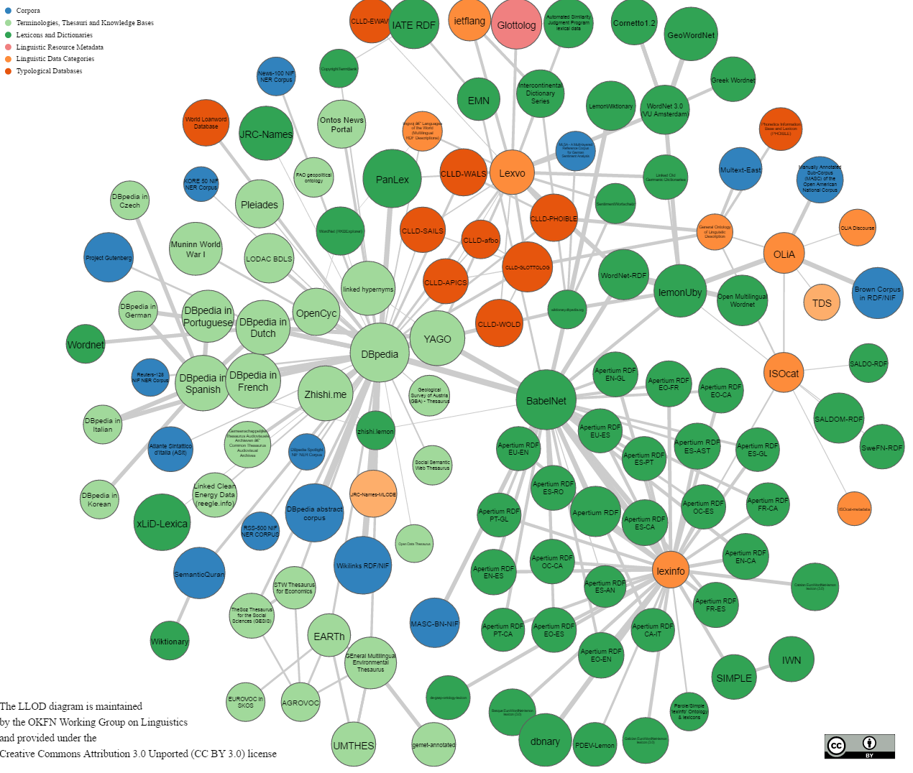

Background Technologies 2
Linguistic Resources (lexical) linked via Uniform Resource Identifiers (URI)
Datasets such as DBpedia, BabelNet, …
Statistical MT
Linked Open Data
Semantic Web Tools
Projects DKT & FREME
4.58 million entities
125 languages
29.8 million links
Notes:
Potential Question: Translation Memories Vs LOD-enriched SMT
Dbpedia: crowd sourced knowledge base
linked data (often capitalized as Linked Data) is a method of publishing structured data so that it can be interlinked and become more useful through semantic queries.

Slide 11

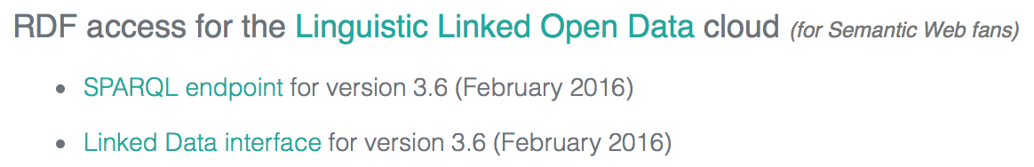

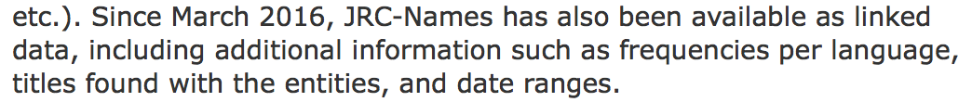
Other Examples of Linked Data
14 million entries
270 languages
> 205,000 entries
20+ languages
Notes:
Babelnet: multilingual dictionary, 14 million entries, 270 languages
Jrc-names: multilingual named entity resource: 205k named entities, 20+ languages

Slide 12
Background Technologies 3
Tools & technologies which help us access linked data on the web
Semantic Web (Web 3.0)
  Making links so that a person or a machine can explore the web of data
Statistical MT
Linked Open Data
Semantic Web Tools
Projects DKT & FREME
Notes:
Potential Question: Translation Memories Vs LOD-enriched SMT

Slide 13
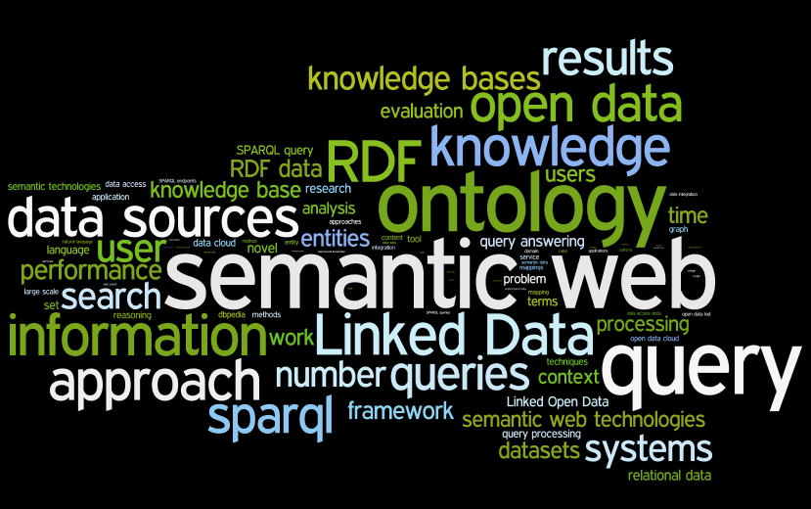

Slide 14
Background Technologies 3
RDF
  Resource Description Framework
  XML-like formalism for data on web
NIF
  NLP Interchange Format
  RDF-based interoperability framework
SPARQL
  Sparql Protocol and RDF Query Language
  Language to retrieve information from RDF-encoded data
Statistical MT
Linked Open Data
Semantic Web Tools
Projects DKT & FREME
Notes:
Potential Question: Translation Memories Vs LOD-enriched SMT

Slide 15

Background Technologies 4
Digital Curation Technologies
  http://digitale-kuratierung.de
FREME
  http://www.freme-project.eu
Statistical MT
Linked Open Data
Semantic Web Tools
Projects DKT & FREME
Notes:
Potential Question: Translation Memories Vs LOD-enriched SMT

Slide 16
Methodology / Recipe
Covert sentence (to be translated) from plaintext to NIF
Notes:
Demonstrate each step graphically / with an example

Slide 17
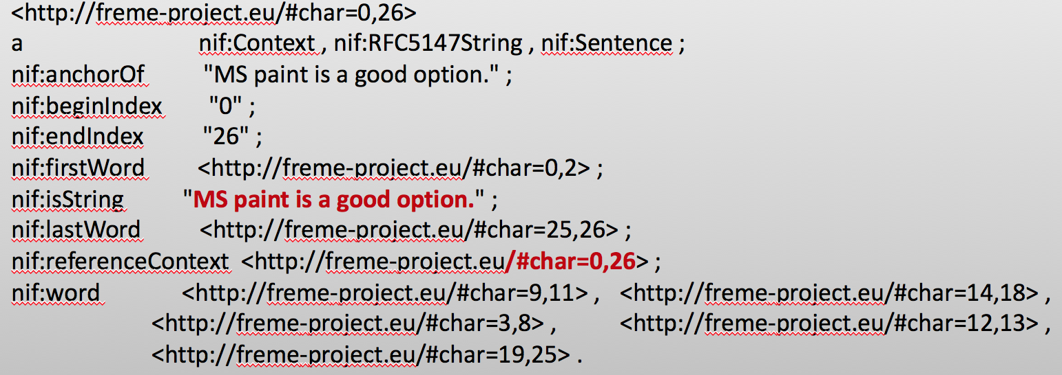
Methodology: NIF Document

Slide 18
Methodology / Recipe
Covert sentence (to be translated) from plaintext to NIF
Perform Named Entity Recognition (Tag the entities)
Entity Linking (DBpedia spotlight) (Link to Dbpedia entries)
Notes:
Demonstrate each step graphically / with an example

Slide 19
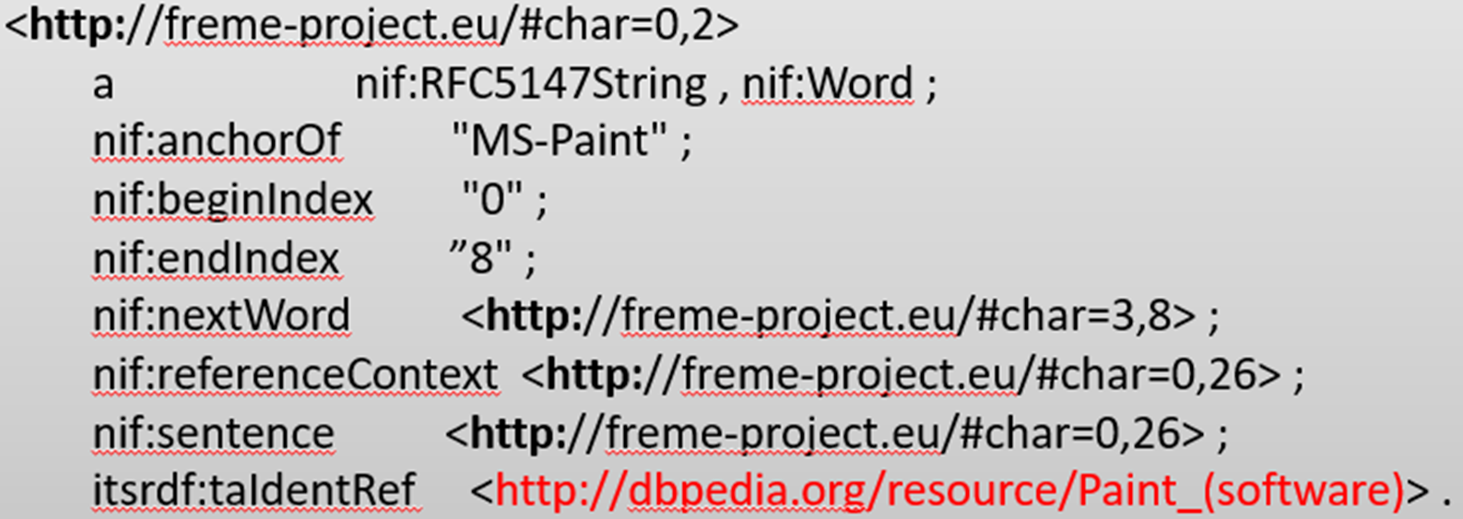
Methodology: NIF with DBPedia Entity
<http://freme-project.eu/#char=0,2>
a nif:RFC5147String , nif:Word ;
nif:anchorOf "MS-Paint" ;
nif:beginIndex "0" ;
nif:endIndex ”8" ;
nif:nextWord <http://freme-project.eu/#char=3,8> ;
nif:referenceContext <http://freme-project.eu/#char=0,26> ;
nif:sentence <http://freme-project.eu/#char=0,26> ;
itsrdf:taIdentRef <http://dbpedia.org/resource/Paint_(software)> .

Slide 20
Methodology / Recipe
Covert sentence (to be translated) from plaintext to NIF
Perform Named Entity Recognition (Tag the entities)
Entity Linking (DBpedia spotlight) (Link to Dbpedia entries)
Retrieve target language translation (SPARQL query)
Notes:
Demonstrate each step graphically / with an example

Slide 21
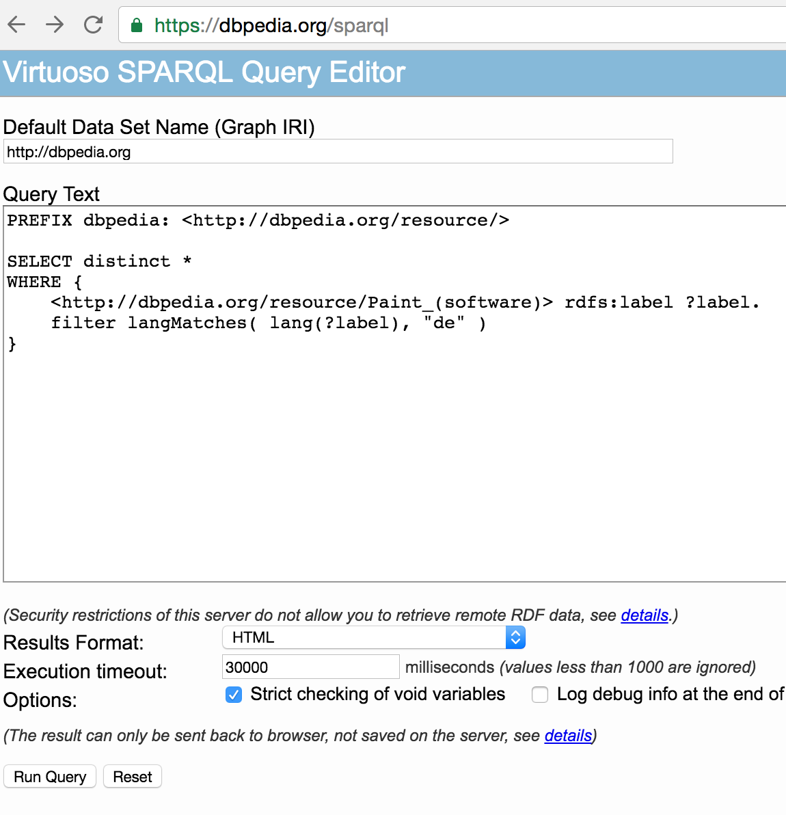

Slide 22
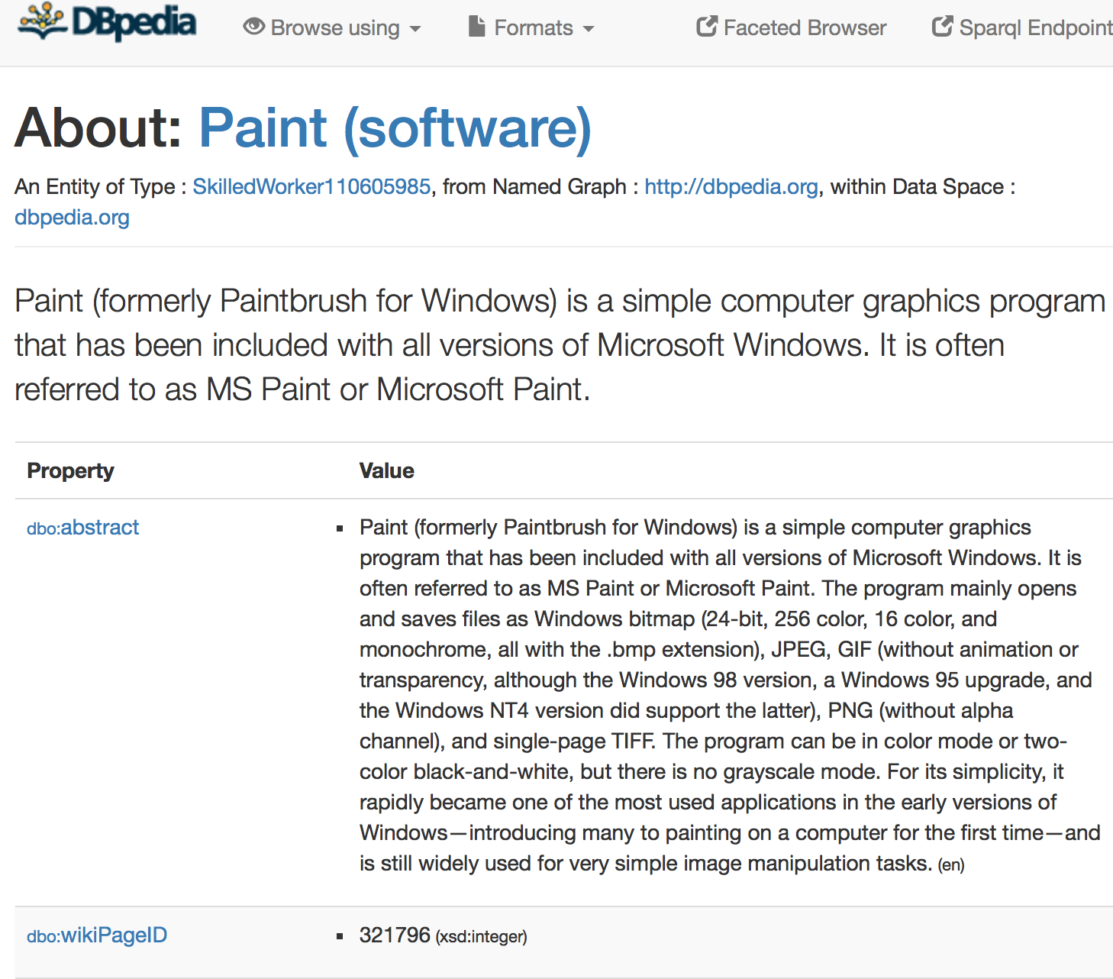
http://dbpedia.org/page/Paint_(software)

Slide 23
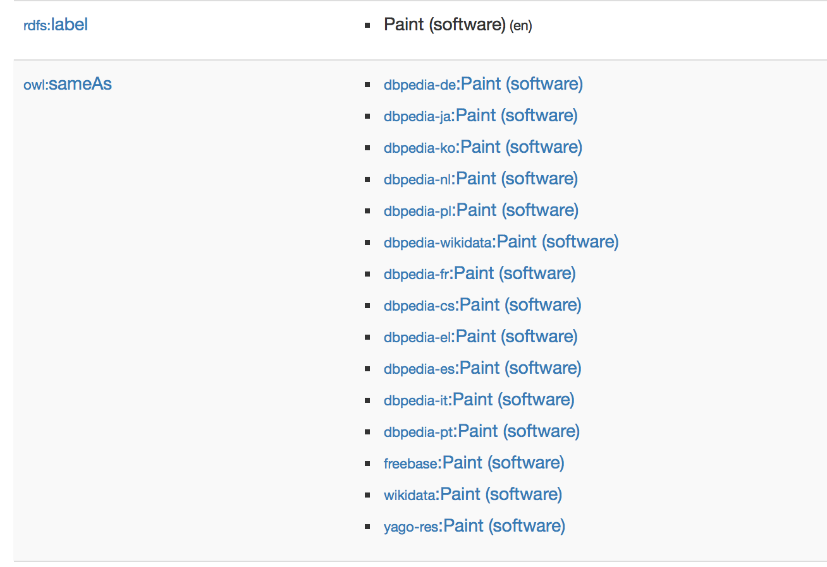

Slide 24
Methodology / Recipe
Covert sentence (to be translated) from plaintext to NIF
Perform Named Entity Recognition (Tag the entities)
Entity Linking (DBpedia spotlight) (Link to Dbpedia entries)
Retrieve target language translation (SPARQL query)
Translate using Moses (xml-input)
Display output
Notes:
Demonstrate each step graphically / with an example

Slide 25
Methodology: Moses Command
% echo '<np translation="Microsoft Paint">MS Paint</np> is a good option ."| moses -xml-input exclusive -f moses.ini

Slide 26
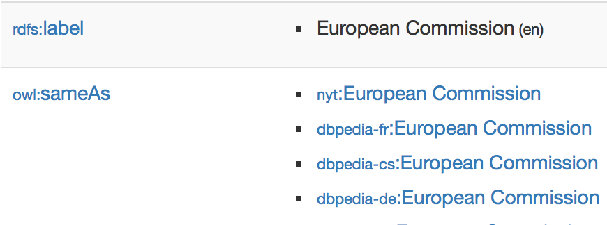
Methodology / Recipe
Identify the DBpedia entry for an entity
Retrieve the linked target language translation via SPARQL query on rdfs:label
Send the alternate translation to MT decoder
Get the correct MT output
4
3
2
1
Moses Statistical Machine Translation
Notes:
To further illustrate the mechanism, we use example (1) from the previous slide “European Commission”
Note this slide has animation (sequential appearance with a click)
Step 1: Execute NER on input text using DBpedia as a resource. Identify “European Commission” as an entity and retrieve its resource link: http://dbpedia.org/page/European_Commission
Step 2: Via SPARQL query on properties rdfs:label and owl:sameAs, retrieve the corresponding German DBpedia page “dbpedia-de:European Commission”: http://de.dbpedia.org/page/Europäische_Kommission
Step 3: Send it to Moses SMT system (in-house DKT) with the decoder feature xml-input switched on to force the decoder to use this translation for European Commission
Display output

Slide 27
Experimental Evaluation
English-German IT-domain (WMT 2016 Shared Task)
Named Entity Forced Translations
Translating 1000 segments
  Bleu Score Improvement from 34.0 to 34.8
  12% more terms were translated correctly than baseline

Slide 28
Critical Analysis
Competing Alternatives
  Other ontology schemas
Advantages
  User-defined, constantly updated
  Consistency of Terminology
Weaknesses
  User-defined data, error-prone
  Entity Linking Errors

Slide 29
Endnote
Easily implementable modules
Available on GitHub: https://github.com/dkt-projekt
A Step towards making Machine Translation Semantic Web Aware

Slide 30
THANKS!
Any Questions?
Ankit.Srivastava@dfki.de

Slide 31

Links to References
Ankit.Srivastava@dfki.de
DBpedia: http://wiki.dbpedia.org
DBpedia Spotlight: https://github.com/dbpedia-spotlight/
DKT: http://digitale-kuratierung.de
DKT GitHub: https://github.com/dkt-projekt
FREME: http://www.freme-project.eu
FREME GitHub: https://github.com/freme-project
Moses: http://www.statmt.org/moses/
NIF: http://persistence.uni-leipzig.org/nlp2rdf/
SPARQL: http://www.w3.org/TR/rdf-sparql-query/

