Slide 1
Why XLIFF and Why XLIFF 2 ?
David Filip
OASIS XLIFF OMOS TC Chair
OASIS XLIFF TC Secretary, Editor, Liaison Officer
Spokes Research Fellow
ADAPT Centre
KDEG, Trinity College Dublin
The ADAPT Centre is funded under the SFI Research Centres Programme (Grant 13/RC/2106) and is co-funded under the European Regional Development Fund.

Slide 2
What is XLIFF?
XML Localisation/Localization Interchange File Format
The only open standard bitext format
XLIFF 1.2 OASIS Standard since Feb 2008
Superseded by XLIFF 2.0 on 5th August 2014
To be superseded by XLIFF 2.1 by June 2017
XLIFF Version 2.1 now under 1st Public Review!
https://multilingual.com/language-in-the-news/xliff-2-1-open-public-review/

Slide 3
XLIFF 2.1 First Public Review
The first “dot” release after XLIFF 2.0 delivers on the
modularity promise of the XLIFF 2 architecture.
XLIFF 2.1 defines two (2) new namespaces and brings a full native ITS 2.0 capability via its ITS Module without breaking the backwards compatibility with XLIFF 2.0.
XLIFF 2 Core and 7 out of 8 XLIFF 2.0 Modules are unaffected by the 2.1 release.
Apart from a major bugfix for the Change Tracking Module and the brand new ITS module, XLIFF 2.1 brings Advanced Validation capability. XLIFF 2.1 (and XLIFF 2.0 also) can be now 100% validated with standardized validation artifacts without regress to custom validation code. The expressivity of the validation framework was greatly enhanced by the usage of Schematron and NVDL schema languages on top of XML Schemas (xsd) that were available in XLIFF 2.0.

Slide 4
Back to the basics
Bitext
Bitext Management
---------------------
Open Standards
Transparency of development and publishing
Availability under Royalty Free (RF) conditions
---------------------
Evolution and Adoption of Bitext formats
Overview of XLIFF 2 data structure
Takeaways

Slide 5
Bitext
A structured (usually mark up language based) artefact that contains aligned source (natural language) and target (natural language) sentences. We consider bitext to be ordered by default (such as in an XLIFF file – defined below, an “unclean” rtf file, or a proprietary database representation). Nevertheless, unordered bitext artefacts like translation memories (TMs) or terminology bases (TBs) can be considered special cases of bitext or bitext aggregates, since the only purpose of TM as an unordered bitext is to enrich ordered bitext, either directly or through training a Machine Translation engine.
(Filip, 2012) (Filip and Ó Conchúir, 2011)

Slide 6
Bitext
A structured (usually mark up language based) artefact that contains aligned source (natural language) and target (natural language) sentences. We consider bitext to be ordered by default (such as in an XLIFF file – defined below, an “unclean” rtf file, or a proprietary database representation). Nevertheless, unordered bitext artefacts like translation memories (TMs) or terminology bases (TBs) can be considered special cases of bitext or bitext aggregates, since the only purpose of TM as an unordered bitext is to enrich ordered bitext, either directly or through training a Machine Translation engine.
(Filip, 2012) (Filip and Ó Conchúir, 2011)

Slide 7
Bitext
Tyger Tyger, burning bright, Tygře, tygře, ohnivou
In the forests of the night; září svítíš lesní tmou!
What immortal hand or eye, Kdo ten nesmrtelný byl,
Could frame thy fearful symmetry?
že z ní tvůj souměr sestrojil?
William Blake / Jaroslav Skalický

Slide 8
Bitext
Tyger Tyger, burning bright, Tygře, tygře, ohnivou
In the forests of the night; září svítíš lesní tmou!
What immortal hand or eye, Kdo ten nesmrtelný byl,
Could frame thy fearful symmetry? že z ní tvůj souměr sestrojil?
Willian Blake Jaroslav Skalický

Slide 9
Bitext
<source>Tyger Tyger, burning bright, </source> <target>Tygře, tygře, ohnivou </target>
<source>In the forests of the night; </source> <target>září svítíš lesní tmou! </target>
<source>What immortal hand or eye, </source> <target>Kdo ten nesmrtelný byl, </target>
<source>Could frame thy fearful symmetry? </source>
<target>že z ní tvůj souměr sestrojil? </target>

Slide 10
Bitext
msgid "Tyger Tyger, burning bright, "
msgstr "Tygře, tygře, ohnivou "
msgid "In the forests of the night; "
msgstr "září svítíš lesní tmou! "
msgid "What immortal hand or eye, "
msgstr "Kdo ten nesmrtelný byl, "
msgid "Could frame thy fearful symmetry? "
msgstr "že z ní tvůj souměr sestrojil? "

Slide 11
Bitext
<source xml:lang= "EN">Tyger Tyger, burning bright, </source> <target xml:lang= "CS">Tygře, tygře, ohnivou </target>
<source xml:lang="EN">In the forests of the night; </source> <target xml:lang="CS">září svítíš lesní tmou! </target>
<source xml:lang="EN">What immortal hand or eye, </source> <target xml:lang="CS">Kdo ten nesmrtelný byl, </target>
<source xml:lang="EN">Could frame thy fearful symmetry? </source>
<target xml:lang="CS">že z ní tvůj souměr sestrojil? </target>

Slide 12
Bitext
<unit id=1>
<segment>
<source xml:lang="EN">Tyger Tyger, burning bright, </source> <target xml:lang="CS">Tygře, tygře, ohnivou </target>
</segment>
<segment>
<source xml:lang="EN">In the forests of the night; </source> <target xml:lang="CS">září svítíš lesní tmou! </target>
</segment>
<segment>
<source xml:lang="EN">What immortal hand or eye, </source> <target xml:lang="CS">Kdo ten nesmrtelný byl, </target>
</segment>
<segment>
<source xml:lang="EN">Could frame thy fearful symmetry? </source>
<target xml:lang="CS">že z ní tvůj souměr sestrojil? </target>
</segment>
</unit>

Slide 13
Bitext management
[Bitext Management is a g]roup of processes that consist of high and low level manipulation of ordered and/or unordered bitext artefacts. Agents can be both human and machine. Usually the end purpose of Bitext Management is to create target (natural language) content from source (natural language) content, typically via other enriching Bitext Transforms, so that Bitext Management Processes are usually enclosed within a bracket of source content extraction and target content re-import.
(Filip, 2012) (Filip and Ó Conchúir, 2011)

Slide 14
Bitext management
[Bitext Management is a g]roup of processes that consist of high and low level manipulation of ordered and/or unordered bitext artefacts. Agents can be both human and machine. Usually the end purpose of Bitext Management is to create target (natural language) content from source (natural language) content, typically via other enriching Bitext Transforms, so that Bitext Management Processes are usually enclosed within a bracket of source content extraction and target content re-import.
(Filip, 2012) (Filip and Ó Conchúir, 2011)

Slide 15
XLIFF Roundtrip example
Courtesy of Arle Lommel and Alan Melby

Slide 16
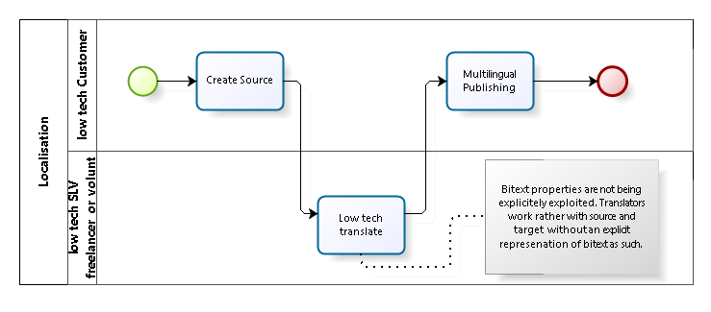
Bitext management?

Slide 17
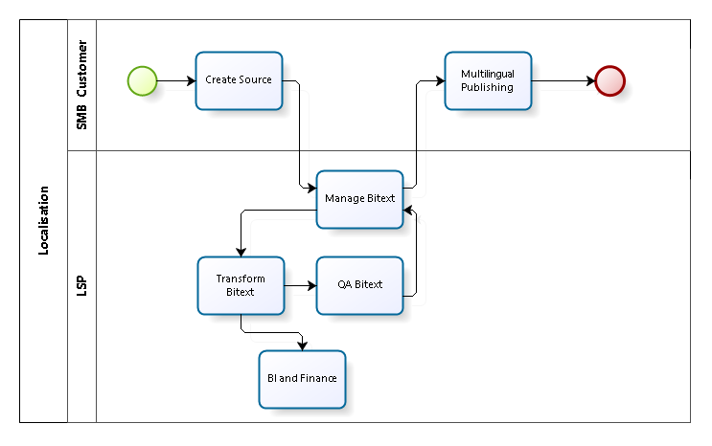
Bitext management – SMBs don’t manage bitext

Slide 18
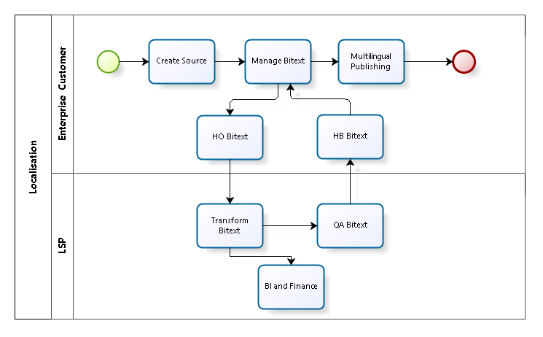
Bitext management – corporations do manage bitext

Slide 19
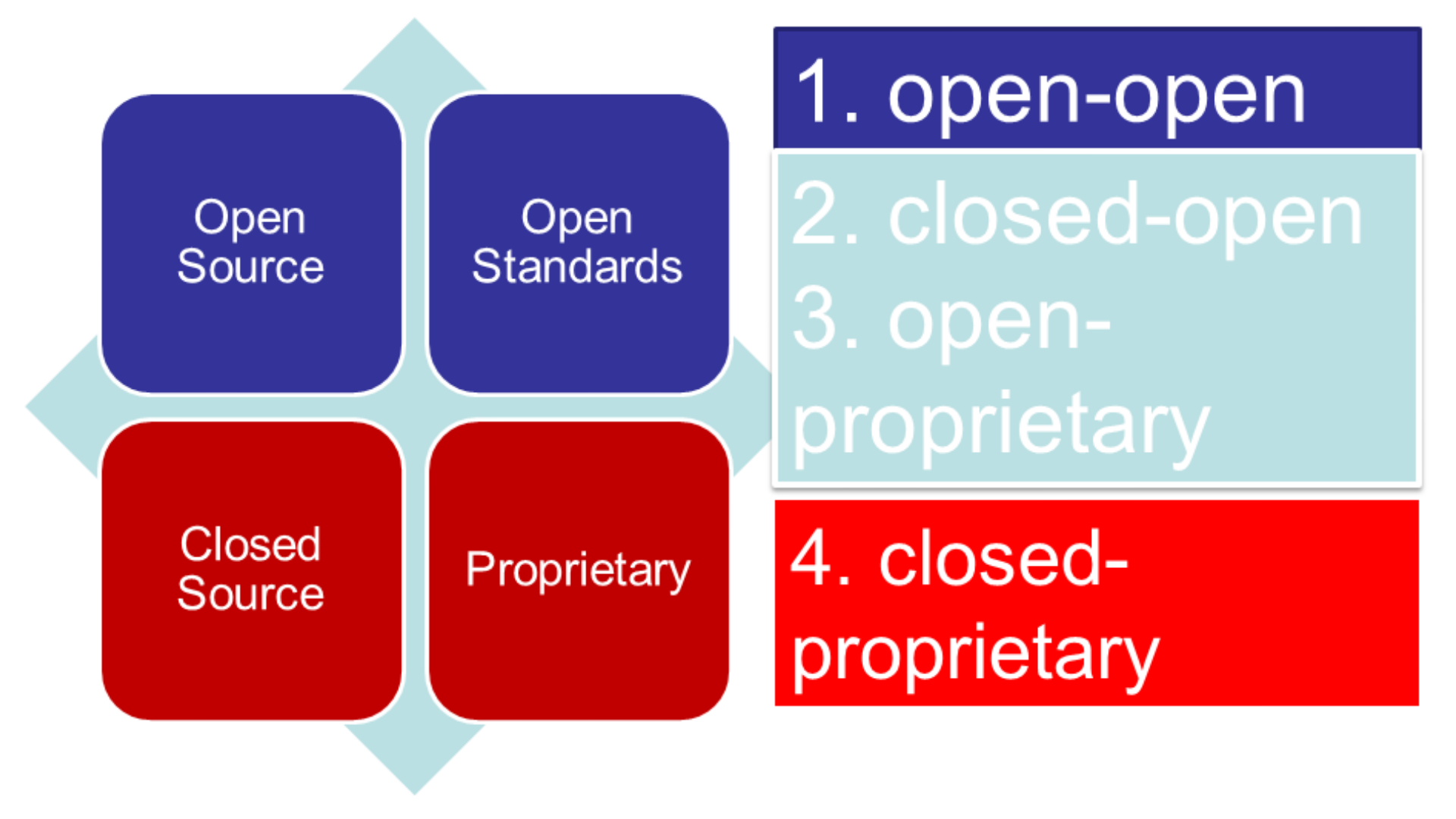
Open Standards
https://www.dropbox.com/s/m9nhytgetegn0by/Screenshot%202016-11-17%2000.41.42.png?dl=0

Slide 20
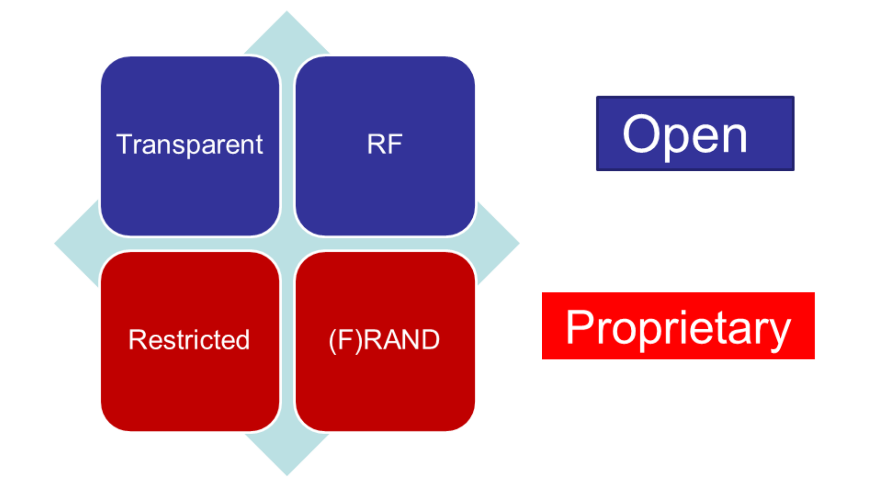
Open Standards
https://www.dropbox.com/s/m9nhytgetegn0by/Screenshot%202016-11-17%2000.41.42.png?dl=0

Slide 21
Evolution and adoption of bitext formats
rtf based scripts po gettext
| |
V |
XML based proprietary |
| |
V |
XLIFF 1.x <------------------------------------------
|
V
XLIFF 2.x
|
V
LIFF OM -------→ JLIFF or JLIMF?, protobufLIFF, YALIFF etc.

Slide 22
XLIFF 2 Data Model

Slide 23
Modular Design
Mandatory
Core
Optional
Modules
Custom
Extensions

Slide 24
Intent of Modular Design
Interoperability
Adaptability
Core
Modules
Extensions
NON-Negotiable
Guaranteed roundtrip
Optional
Guaranteed survival
Custom/private
Application specific
Should survive roundtrip

Slide 25
XLIFF 2 Overview - Agents
Agent
Writer
Extractor,
Enricher, e.g. reviewer workbench, TM server, MT broker etc.
Modifier, e.g. a translation editor
Merger
Etc. e.g. validator

Slide 26
XLIFF 2 Overview - Core
About 20% of XLIFF 1.2 feature set
An extremely good thing for interoperability
Roundtrip oriented
New segmentation model
New inline text model
All and only features that are necessary to roundtrip source with target translations

Slide 27
XLIFF 2 Overview – Core data model
About 20% of XLIFF 1.2 feature set
An extremely good thing for interoperability
Roundtrip oriented
New segmentation model
New inline text model
All and only features that are necessary to roundtrip source with target translations

Slide 28
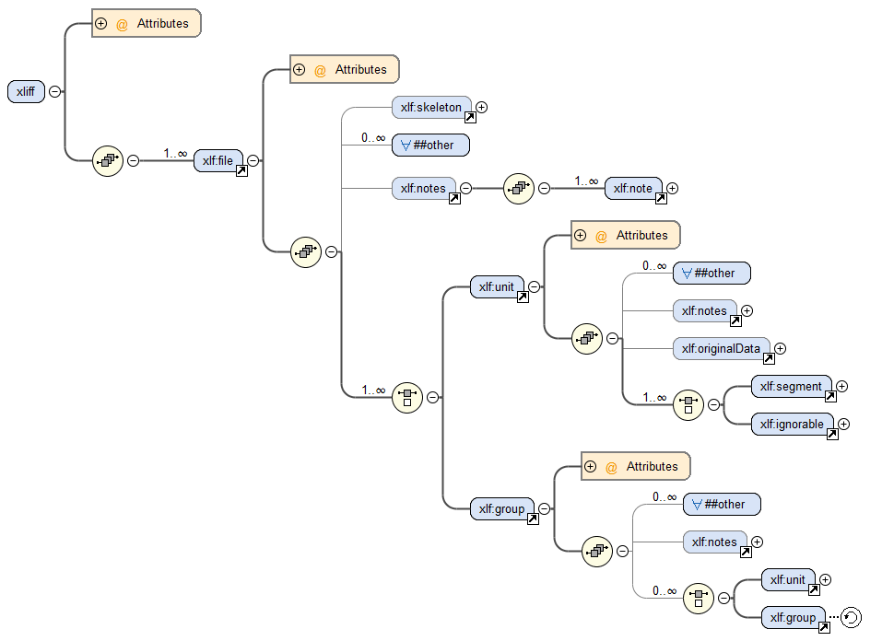
XLIFF 2 data model – top to group recursion

Slide 29
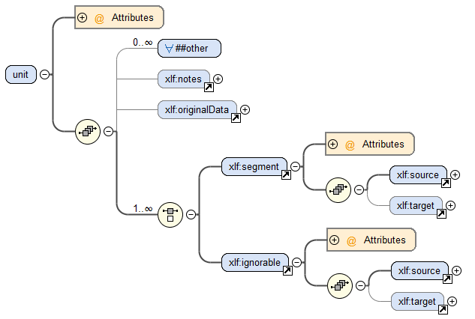
XLIFF 2 data model – unit

Slide 30
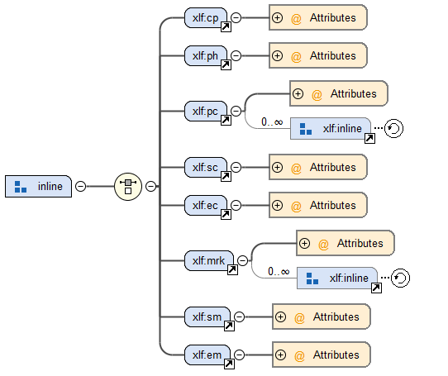
XLIFF 2 data model – Inline

Slide 31
XLIFF 2 Overview - Modules
All else are OPTIONAL features available through MODULES
– Translation Candidates Module
– Glossary Module
– Format Style Module
– Metadata Module
– Resource Data Module
– Change Tracking Module
– Size and Length Restriction Module
– Validation Module

Slide 32
XLIFF 2 Overview - Modules
All else are OPTIONAL features available through MODULES
– Translation Candidates Module 2.0 + ITS
– Glossary Module 2.0
– Format Style Module 2.0
– Metadata Module 2.0
– Resource Data Module 2.0 <- ITS
– Change Tracking Module 2.0 -> 2.1
– Size and Length Restriction Module 2.0 <- ITS
– Validation Module 2.0
– ITS Module 2.1

Slide 33
The big picture
ITS 1.0
Translate
ITS 2.0
Translate
XLIFF
Translate Annotation
Note
Localization Note
Terminology
Directionality
Ruby
Language Information
Elements Within Text
Localization Note
Terminology
Directionality
Language Information
Elements Within Text
Domain
Text Analysis
Locale Filter
Provenance
External Resource
Target Pointer
ID value
Preserve Space
Localization Quality Issue
Localization Quality Rating
MT Confidence
Allowed Characters
Storage Size
Other standards
Term Annotation
Directionality
Subflows mechanism
Unicode code points, fonts etc.
srcLang, trgLang, xml:lang, itsm:lang
Itsm:domains
ITSM Text Analytics
Extraction / ITSM mechanism
res: module
<source> & <target> siblings
XLIFF specific ID and FRAGID
xml:space
ITSM LQI
ITSM LQR
mtc: module / itsm:mtConfidence
ITSM Allowed Characters
slr: module
TBX
UAX #9
locale specific layouts for HTML
BCP47
TBX
xml:space
MQM
TMX
regular expressions
ctr: module + ITSM Provenance
Dublin Core
IANA media types
xml:id

Slide 34
Industry Adoption of XLIFF 2.0 Second Wave (working now)
Okapi XLIFF Toolkit
https://bitbucket.org/okapiframework/xliff-toolkit http://okapi-lynx.appspot.com/validation
Xmarker - http://www.xmarker.com/node/5
Microsoft – Microsoft Open Sourced their OM implementation
https://github.com/Microsoft/XLIFF2-Object-Model
Lionbridge
Multilizer
memsource
Ocelot
SDL – all products!
AEM
XTM
Et al.

Slide 35
Questions and Answers
Thanks a million for your attention
david.filip@adaptcentre.ie

Slide 36
XLIFF 2 Resources
https://www.oasis-open.org/committees/xliff-omos/
https://github.com/oasis-tcs/xliff-omos-om
https://github.com/oasis-tcs/xliff-omos-jliff
https://tools.oasis-open.org/version-control/browse/wsvn/xliff-omos/trunk/XLIFF-TBX/xliff-tbx-v1.0.pdf
https://www.oasis-open.org/committees/xliff/
http://docs.oasis-open.org/xliff/xliff-core/v2.1/xliff-core-v2.1.html
https://www.oasis-open.org/committees/comments/index.php?wg_abbrev=xliff
https://issues.oasis-open.org/browse/XLIFF/
Presentations from 7th XLIFF Symposium at 5th FEISGILTT at #LocWorld31 Dublin June 7-8, 2016
http://locworld.com/feisgiltt2016-cfp/
Presentations from 6th XLIFF Symposium at 4th FEISGILTT at #LocWorld28 Berlin June 2-3, 2015 http://locworld.com/feisgiltt-program/
FEISGILTT Localisation Focus Volumes
http://www.localisation.ie/locfocus/issues/14/1
http://www.localisation.ie/locfocus/issues/12/1

