Slide 1



The pre-Singularity
An uncertain road ahead
David Wood
@dw2
Chair, London Futurists
Principal, Delta Wisdom
londonfuturists.com
deltawisdom.com

Slide 2
Q: Will all human translators be replaced before the Singularity?
A: It’s too early to tell.
There are many things we still understand insufficiently…
The mind is still mysterious, and software progress is unpredictable.

Slide 3
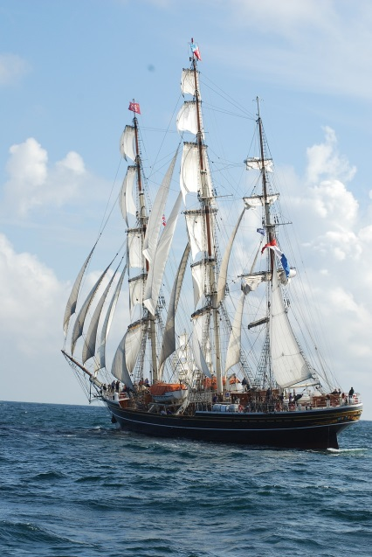
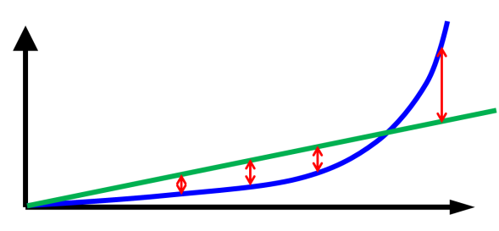
Futurists…
1. Identify scenarios
2. Assess scenarios
3. Explore actions
Opportunities
The set of credible future scenarios
Threats
Trend analysis
Extrapolation ➔
Disruptions
Brakes 
Accelerators 
Business as usual
Interactions

Slide 4
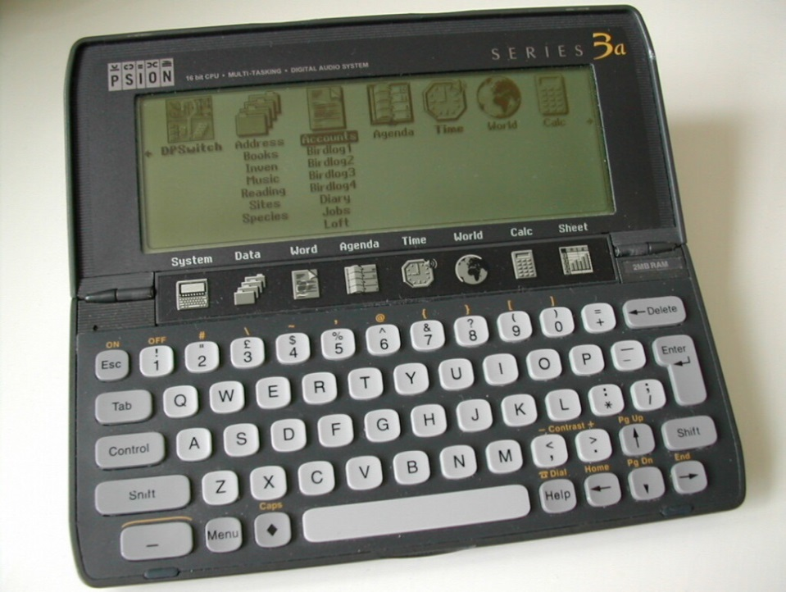
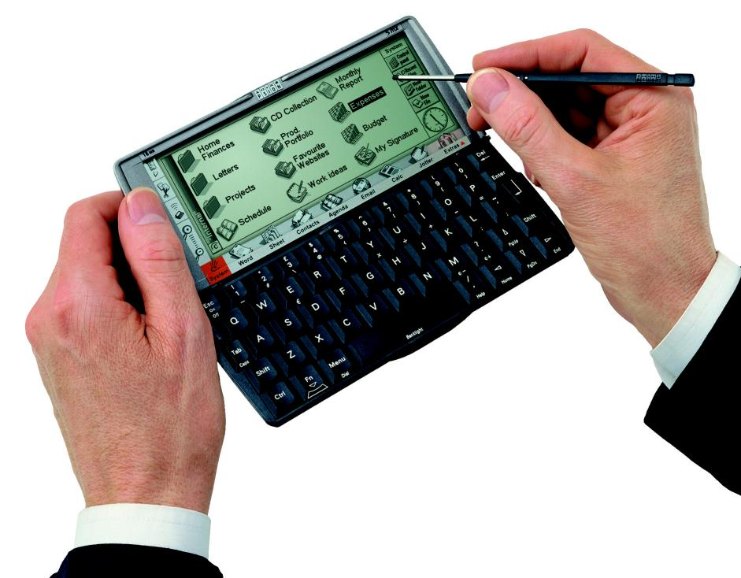
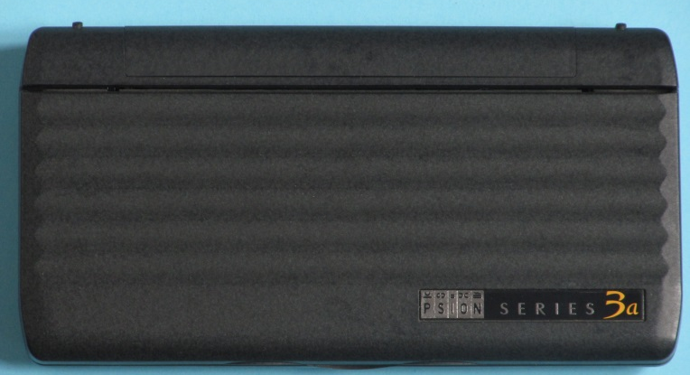


Slide 5


Spotted
trends
Anticipated
convergence
Positive
feedback
cycle
Patiently built a platform for collaboration
Vision: June 1998

Slide 6






Smartphone Capability
Phase 2 smartphones (superphones)
Mini-computers
Software critical
Software important
Supercomputers
Phase 1 smartphones
Software relatively unimportant
Feature phones
(phase 0)
The future arrives in waves
“Software is eating the world”
“Technology is eating the world”
Time
1990
2000
2010

Slide 7
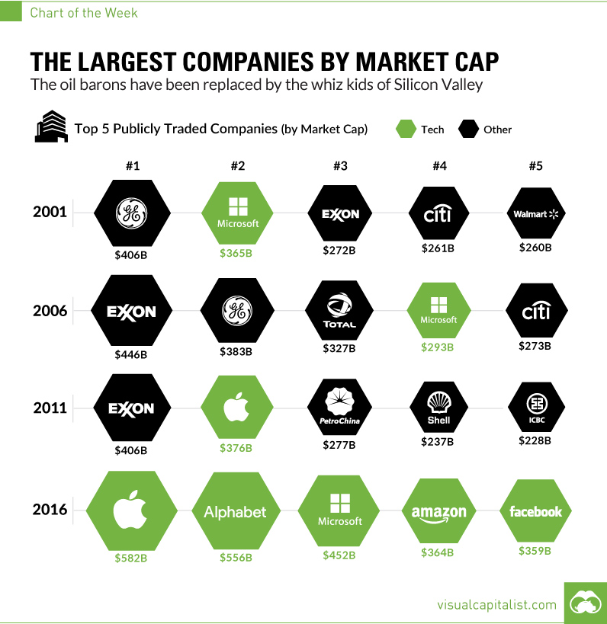
#1
#2
#3
#4
#5
2001
2006
“Technology is eating the world”
2011
2016
http://www.visualcapitalist.com/chart-largest-companies-market-cap-15-years/

Slide 8
Smartphones
Pre-Singularity AI
Huge amounts of software
Intense co-opetition of many developers & many companies
Many delays in the course of development (spurts too)
Many surprises in the course of development
Full social implications not clear in advance
Overall potential very positive
Huge amounts of software
Intense co-opetition of many developers & many organisations
Many delays in the course of development (AI winters…)
Many surprises in the course of development(?)
Full social implications not clear in advance
Overall potential very positive(?)

Slide 9
Smartphone Capability
AI
Capability
Phase 2 smartphones (superphones)
Superhuman AI (ASI)?
Works out own goals(?)
Phase 1 smartphones
AI with Deep Learning?
Works out own methods,
follows given goals
Feature phones
(phase 0)
The future arrives in waves
Narrow AI
Follows given goals & methods
Time
1990
2000
2010

Slide 10
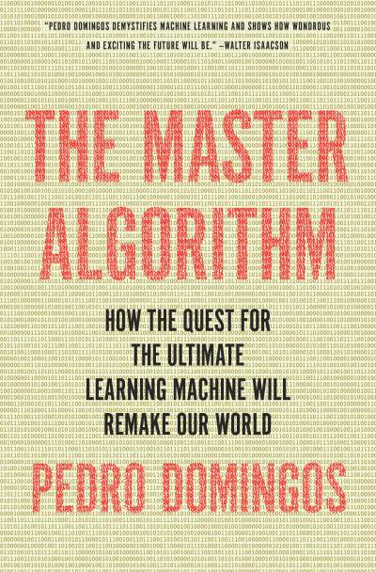
“The Master Algorithm”
Pedro Domingos, 2015
Multi-convergence of “tribes”
Tribe | Origin | Core algorithm
Symbolists | Logic & philosophy | inverse deduction
Connectionists | Neuroscience | back-propagation
Evolutionaries | Evolutionary biology | genetic programming
Bayesians | Statistics | probability inference
Analogizers | Psychology | kernel machines
“How the quest for the ultimate learning machine will remake our world”

Slide 11

Likely date of advent of HL-AGI
Population | 10% | 50% | 90%
Conference: Philosophy & Theory of AI
Conference: Artificial General Intelligence
Greek Association for Artificial Intelligence
Top 100 cited academic authors in AI
Combined (from above)
Nick Bostrom: Superintelligence

Slide 12
Likely date of advent of HL-AGI
Population | 10% | 50% | 90%
Conference: Philosophy & Theory of AI |  | 2048
Conference: Artificial General Intelligence |  | 2040
Greek Association for Artificial Intelligence |  | 2050
Top 100 cited academic authors in AI |  | 2050
Combined (from above) |  | 2040
Nick Bostrom: Superintelligence

Slide 13
Likely date of advent of HL-AGI
Population | 10% | 50% | 90%
Conference: Philosophy & Theory of AI |  | 2048 | 2080
Conference: Artificial General Intelligence |  | 2040 | 2065
Greek Association for Artificial Intelligence |  | 2050 | 2093
Top 100 cited academic authors in AI |  | 2050 | 2070
Combined (from above) |  | 2040 | 2075
Nick Bostrom: Superintelligence

Slide 14
Likely date of advent of HL-AGI
Population | 10% | 50% | 90%
Conference: Philosophy & Theory of AI | 2023 | 2048 | 2080
Conference: Artificial General Intelligence | 2022 | 2040 | 2065
Greek Association for Artificial Intelligence | 2020 | 2050 | 2093
Top 100 cited academic authors in AI | 2024 | 2050 | 2070
Combined (from above) | 2022 | 2040 | 2075
Nick Bostrom: Superintelligence

Slide 15
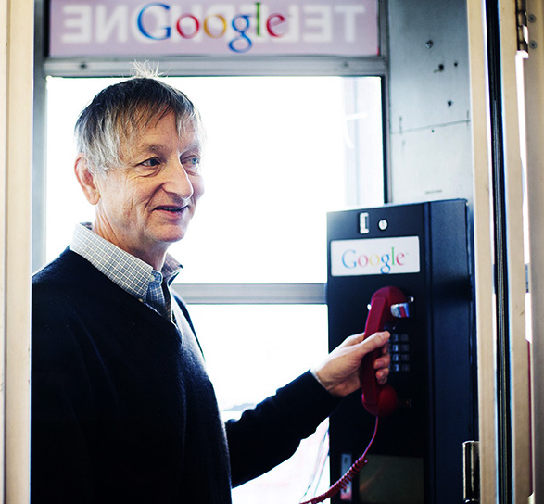
“Computers will have developed ‘common sense’ within a decade
and we could be counting them among our friends not long afterwards”
Geoffrey Hinton
University of Toronto and Google
http://www.macleans.ca/society/science/the-meaning-of-alphago-the-ai-program-that-beat-a-go-champ/
https://www.theguardian.com/science/2015/may/21/google-a-step-closer-to-developing-machines-with-human-like-intelligence

Slide 16
Exponential growth?
ASI>>HL
?
Technology
Technology
AGI=HL
Time
Time
2050
2050
Ray Kurzweil
Eliezer Yudkowsky

Slide 17
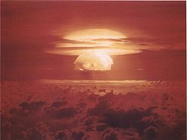
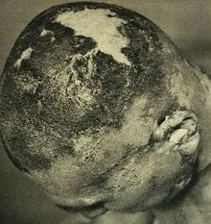
Going nuclear: hard to calculate
First hydrogen bomb test, 1st March 1954, Bikini Atoll
  Explosive yield was expected to be from 4 to 6 Megatons
  Was 15 Megatons, two and a half times
  the expected maximum
  Physics error by the designers at Los
  Alamos National Lab
  Wrongly considered the lithium-7 isotope
  to be inert in bomb
  The crew in a nearby Japanese fishing boat
  became ill in the wake of direct contact
  with the fallout. One of the crew died
http://en.wikipedia.org/wiki/Castle_Bravo

Slide 18
The pre-Singularity: 5 unpredictable forces
Hardware with higher performance: Continuation of Moore’s Law?
  “18 different candidates” in Intel labs to add extra life to that trend
  Hard-to-predict breakthroughs with Quantum Computing?
Software algorithm improvements?
  Can speed things up faster than hardware gains – e.g. chess computers
  Compare: Andrew Wiles, unexpected proof of Fermat’s Last Theorem (1993)
Learnings from studying the human brain?
  Improved scanning techniques -> “neuromorphic computing” etc
  Philosophical insight into consciousness/creativity?!
More people studying these fields than ever before
  Stanford University online course on AI: 160,000 students (23,000 finished it)
  More components / databases / tools /methods ready for re-combination
  Unexpected triggers for improvement (malware wars, games AI, financial AI…)
Transformation in society’s motivation?
  Financial motivation
(Smarter people?!)
“Sputnik moment!?”
http://intelligence.org/2013/05/15/when-will-ai-be-created/

Slide 19
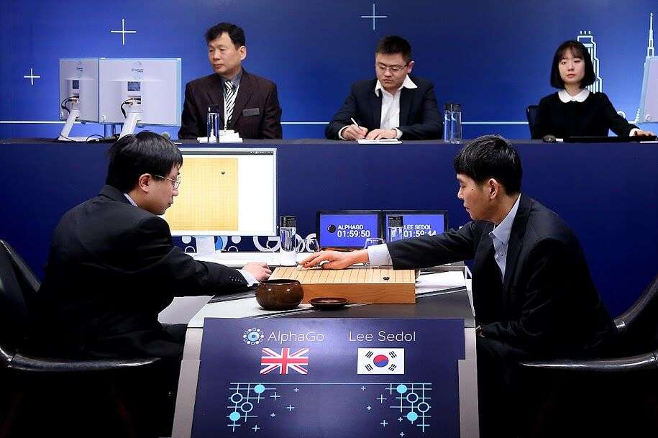
The acceleration of acceleration
“We are 20 years away…”
March 2016
AlphaGo 4,
Lee Sedol 1
AI, Deep Learning => Pattern detection
(Artificial Intuition)

Slide 20
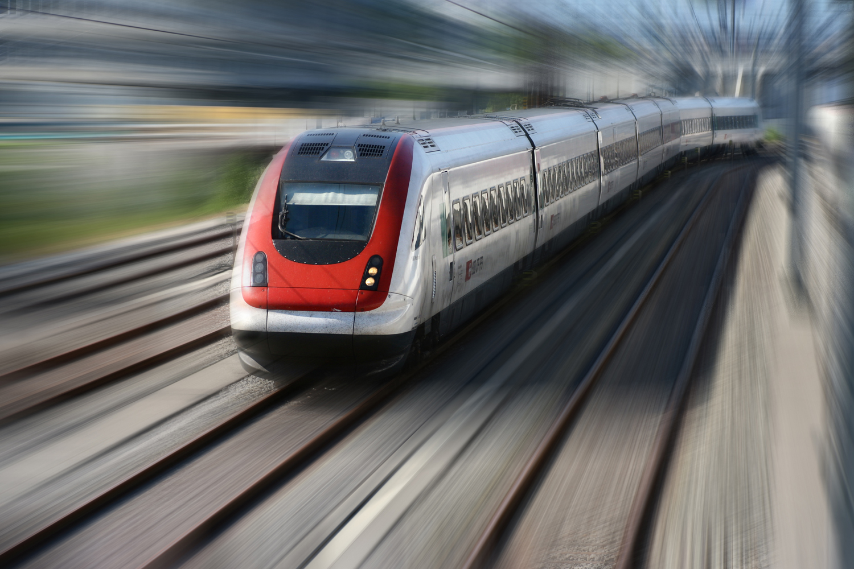
Who here wanted to merge again?
Jaan Tallinn: http://prezi.com/xku9q-v-fg_j/intelligence-stairway/

Slide 21
The pre-Singularity
An uncertain road ahead
David Wood
@dw2
Chair, London Futurists
Principal, Delta Wisdom
londonfuturists.com
deltawisdom.com

